Slide 1
Computer Science, Chapter 1: Data Storage
Presented by: Lilla Ball

Slide 2

Digital Data
-Digital Data is represented by only two values: 0 or 1
-Binary digit(BIT): A number that is either 0 or 1
-Gate: Device that produces a 0 or 1
-Boolean operations: Always result in a 0 or 1

Slide 3
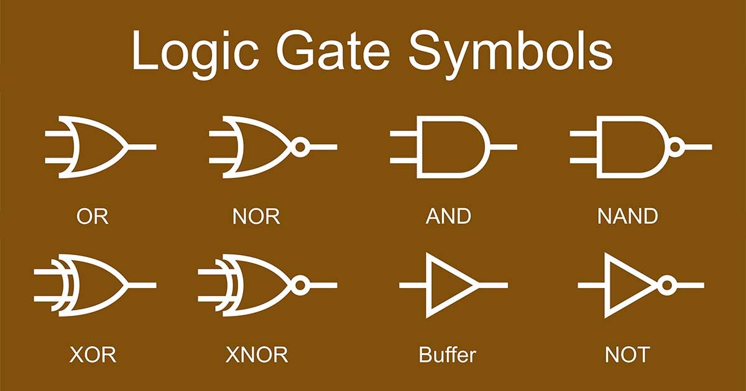
2. Logic Gates
Gates are building blocks that computers are constructed from.
-AND Gate: AND Gates use Boolean multiplication, any binary digit multiplied by 0→ 0. For example 1 multiplied by 1→1.
-OR Gate: OR Gates use Boolean addition, 0 plus 0→0. 1 plus any bit is 1 (including 1+1→1).
-XOR Gate: If two binary digits are the same → 0, if two binary digits are different → 1.
-NOT Gate: Reverses the value of the binary digit.

Slide 4
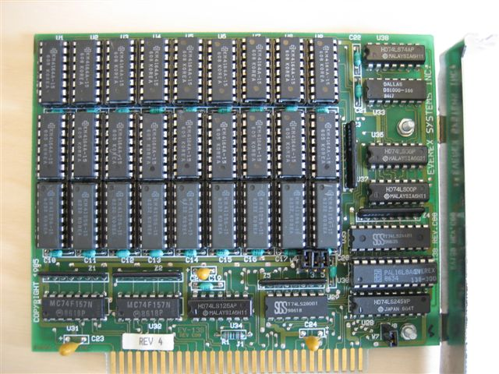
3. Computer Memory
Computer memory is composed of circuits called FLIP FLOPs
-Flip Flops circuits:
-”Hold” a 0 or 1
-Are constructed from logic gates
-The smaller they are, the smaller the overall computer component is
-VLSI:
- VLSI= Very Large Scale Integration
- Millions of flip flops are constructed on a semi-conduct wafer(“chip”)

Slide 5
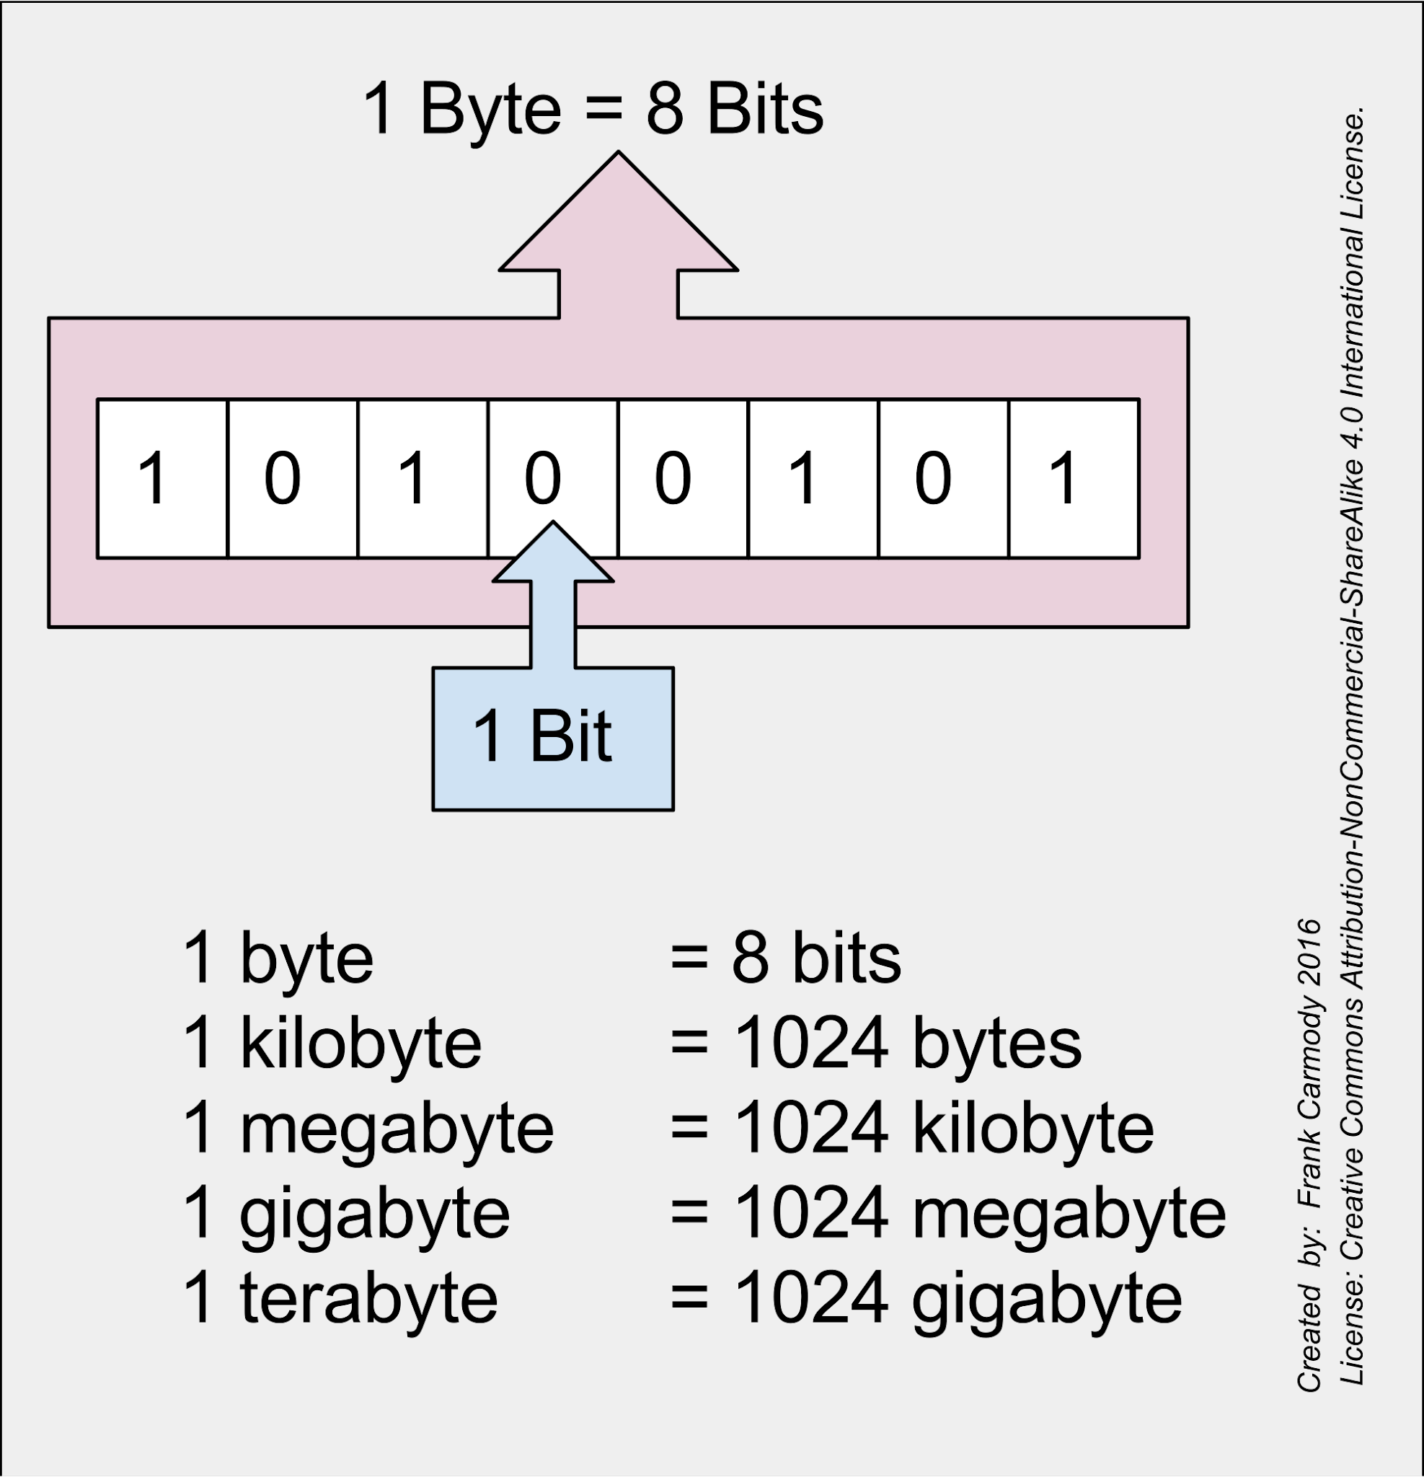

4. Data storage in Bits, Bytes,& Words
-Bit: A circuit that can be a 0 or 1
-Byte: A group of 8 bits
-Word: 16 bits
-Double- word: 32 bits
-Quad-word: 64 bits
These terms are also sometimes used:
-Nibble: A group of 4 bits
-Chomp: A group of 16 bits

Slide 6
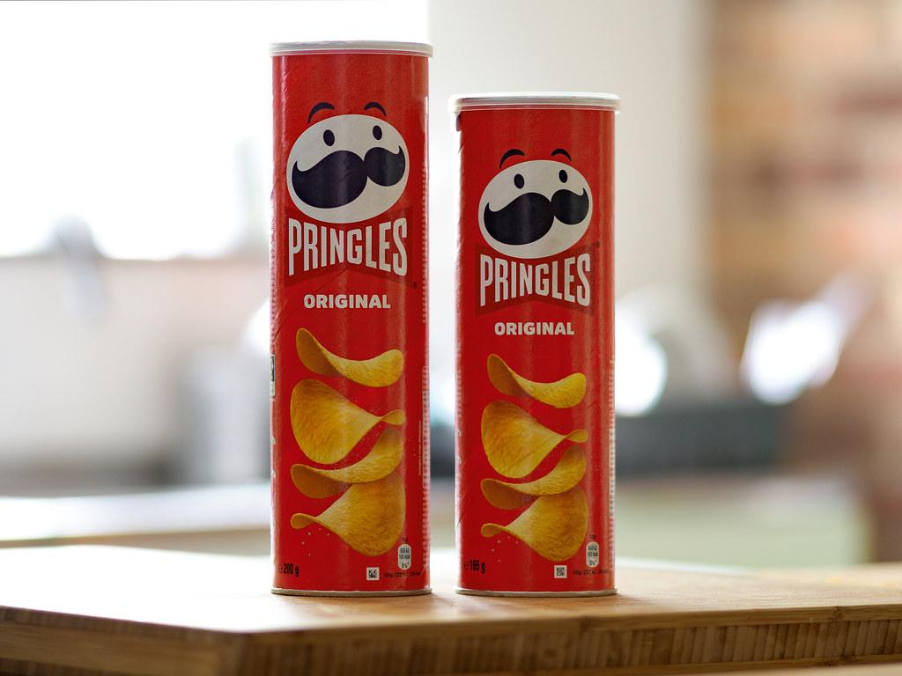
5. Main Memory Organization
Main memory is composed of “cells”, each cell can hold a byte of data ( 8 bits)
-Most significant bit: Is on the “left” side of the byte
-Least significant bit: Is on the “right” side of the byte
Each cell has an “address’ so the computer can find the data stored in the cell
-RAM: Random access memory
Data loss: when power is turned off,all values go to 0, each cell can be assessed independently
-Serial Memory: A cell can only be accessed by going through all the cells before it
-Potato Chip example:
Random access: A bag of potato chips
Serial access: A tube of “ Pringles” type potato chip

Slide 7
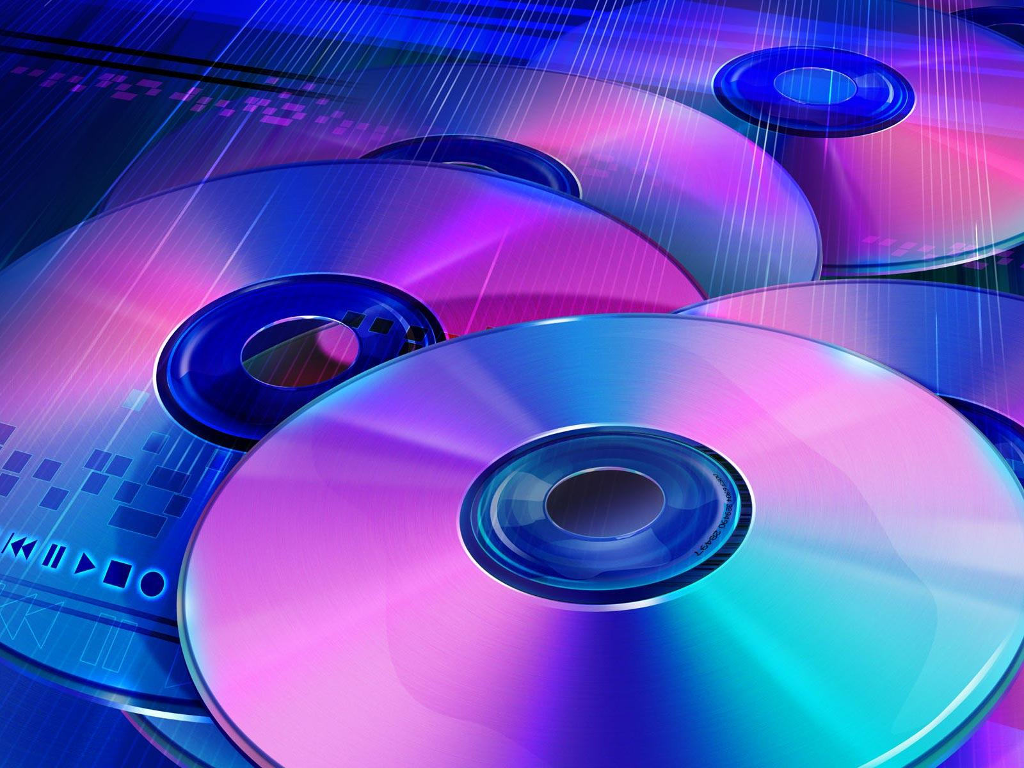
6. Mass Storage
Mass storage is used to backup the data in RAM
Many kinds of mass storage media including:
-Inside the computer: hard drive and/or SSD drives
-Portables: CDs, DVDs, magnetic tape,flash drives, SD drives(Secure Digital)

Slide 8
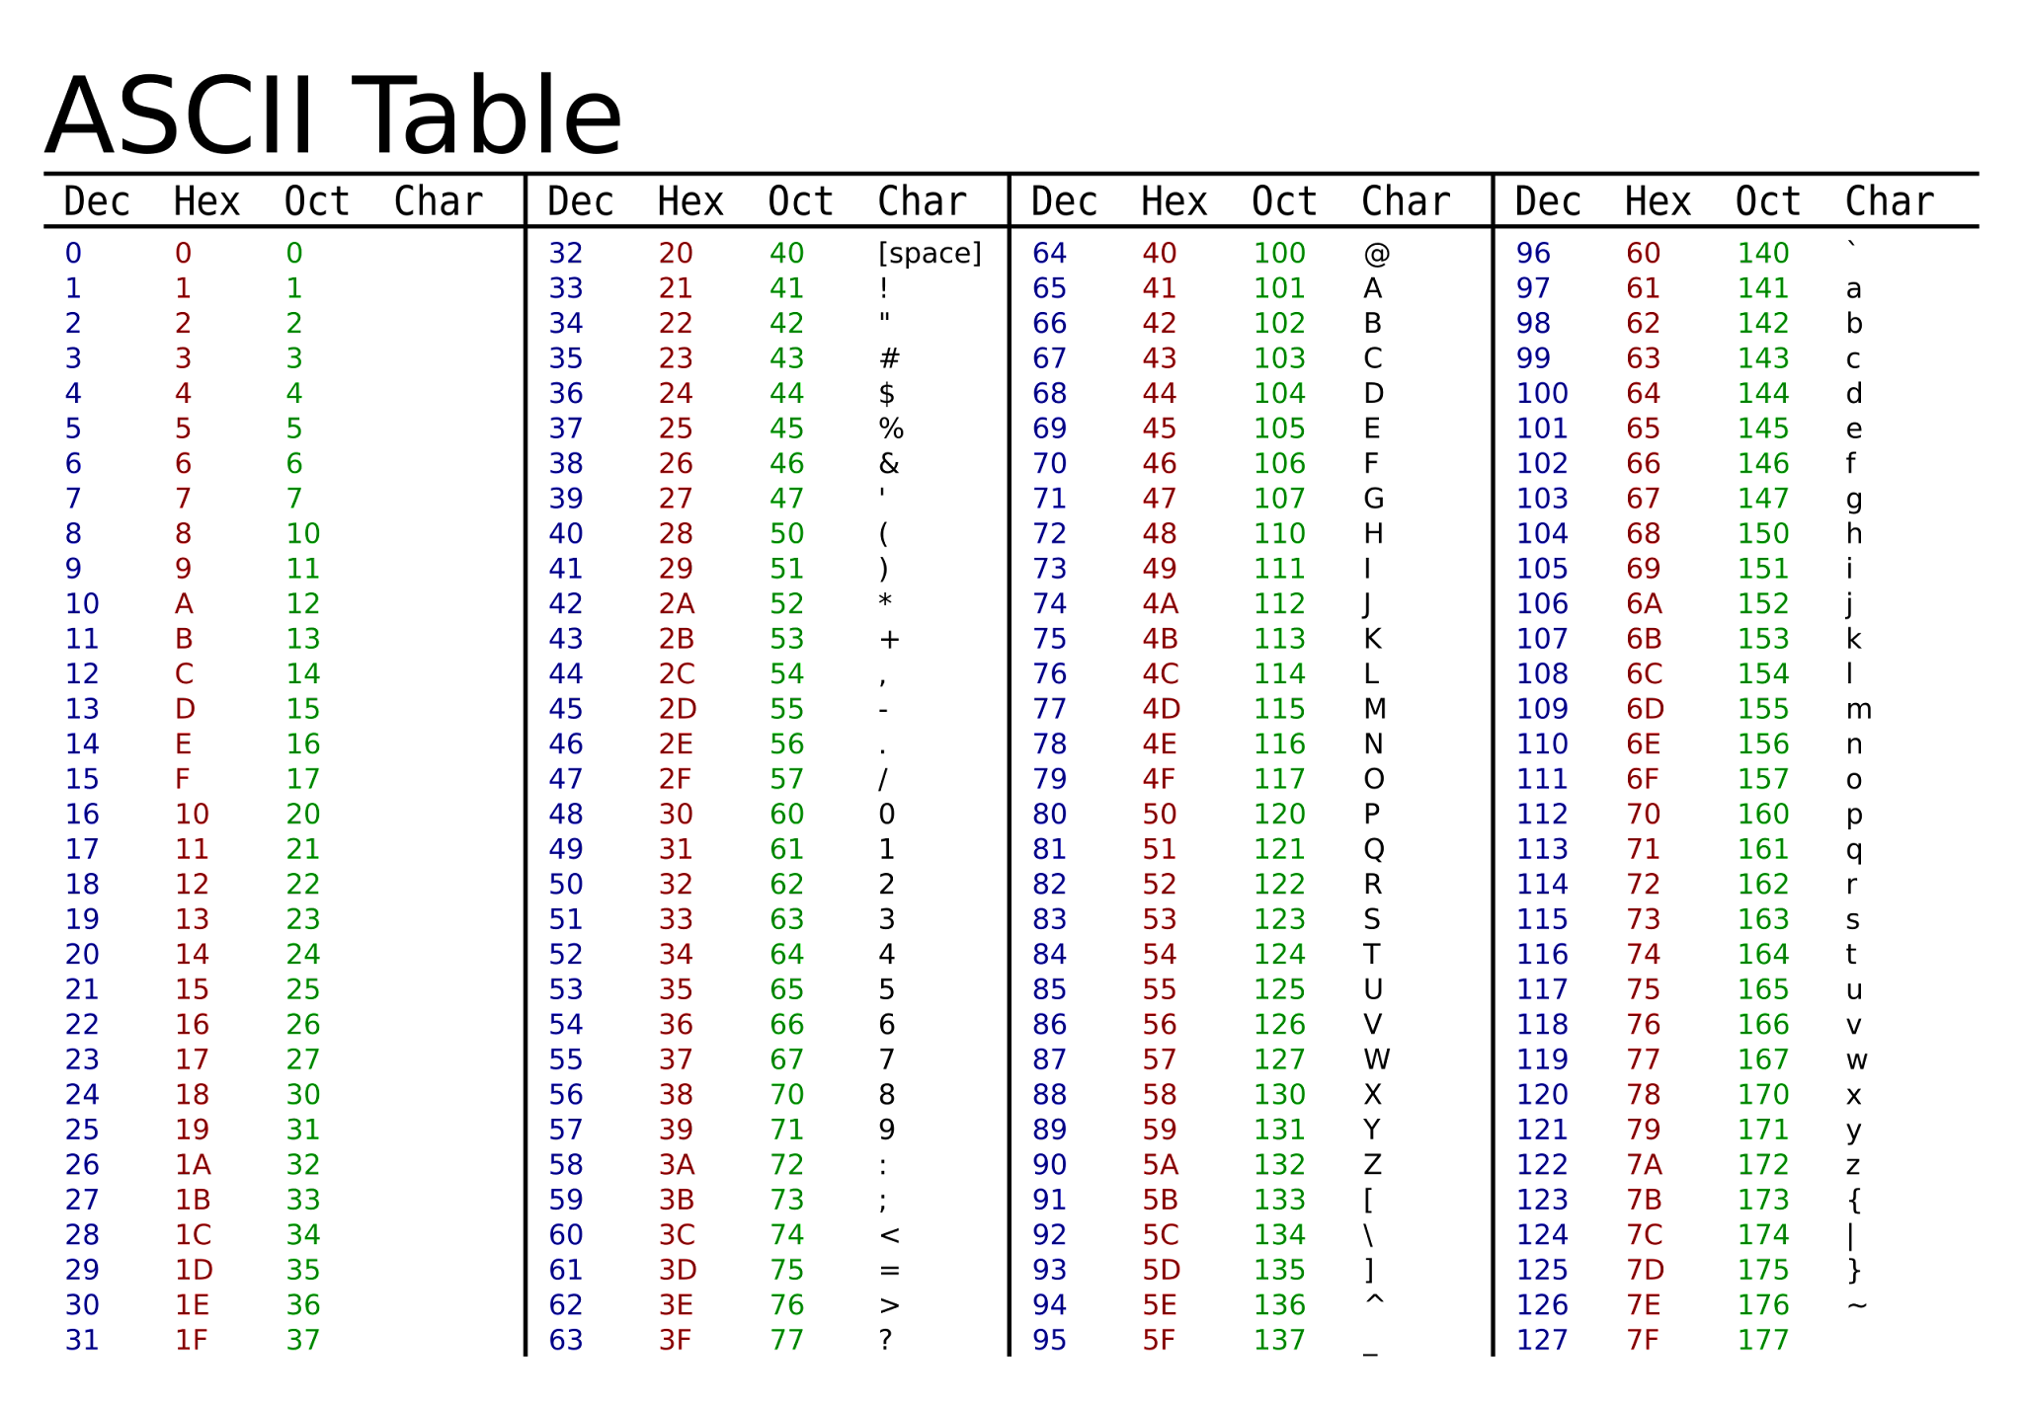
7. How Text Data is Represented
Text Data
-American text data: Uses ASCII (“ AS-kee”) American Standard Code for Information Interchange
-Unicode: Up to 21 bits; supports symbols used in other languages
-UTF-8 (Unicode Transformation Format): combines ASCII with unicode, uses 24 bit or 32 bit patterns for Chinese, Japanese, & Hebrew symbols

